Slide 1
The exploratory analysis of the effect of environmental factors on transmission of COVID-19
Zhaofeng Liu, Uhuru Kamau, Chenhao Zhao, Shuyang Lu, Yifan Zhao
11/11/21

Slide 2
Introduction
The worldwide case total is 249,110,283, with more than 5 million deaths and more than 6 million recoveries
There is a dose-response relationship suggesting a significantly negative relationship between temperature, humidity and covid-19 confirmed cases, the relationship was linear in the range from 16.8 °C to 25.8 °C and then became flat above 25.8 °C
Disease severity and mortality rates due to COVID-19 infection are greater in the elderly and chronically ill patients, populations at high risk for vitamin D deficiency. Vitamin D plays an important role in immune function and inflammation
As very few nutrients naturally contain vitamin D, dietary intake of vitamin D is generally insufficient, Thus sunlight plays a great part in obtaining vitamin D, which can be equally measured by ultraviolet.

Slide 3
Main Aims
Aim 1: the correlation relationship between Temperature, humidity and incident rate of covid-19
Aim2: the impact of Ultraviolet(vitamin D) in conjunction with Aim 1

Slide 4
Row data obtain and method we use
Row Data:
We obtain Covid data frame from JHU and Weather data from API, since relational data matched by date, we merge them to generate our row data.
Method:
Github, Python web scrapper, Tidyverse (R), GGplot2(R), EXCEL(VLOOKUP&IF), SQL, PerformanceAnalytics(R),

Slide 5
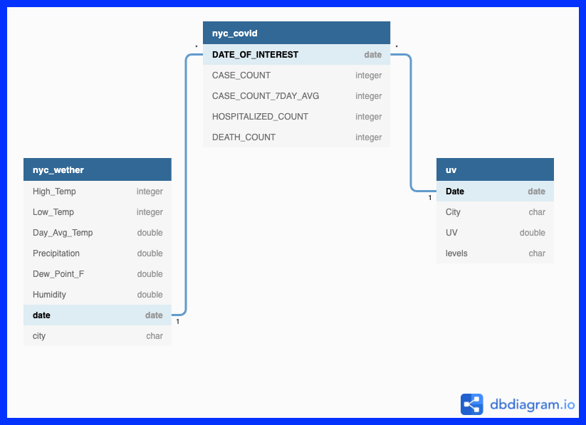
Row data Collection

Slide 6
Data Wrangling
GITHUB: version control and sharing file/storage
Variable Calculation:
Dealing with Missing Data:

Slide 7
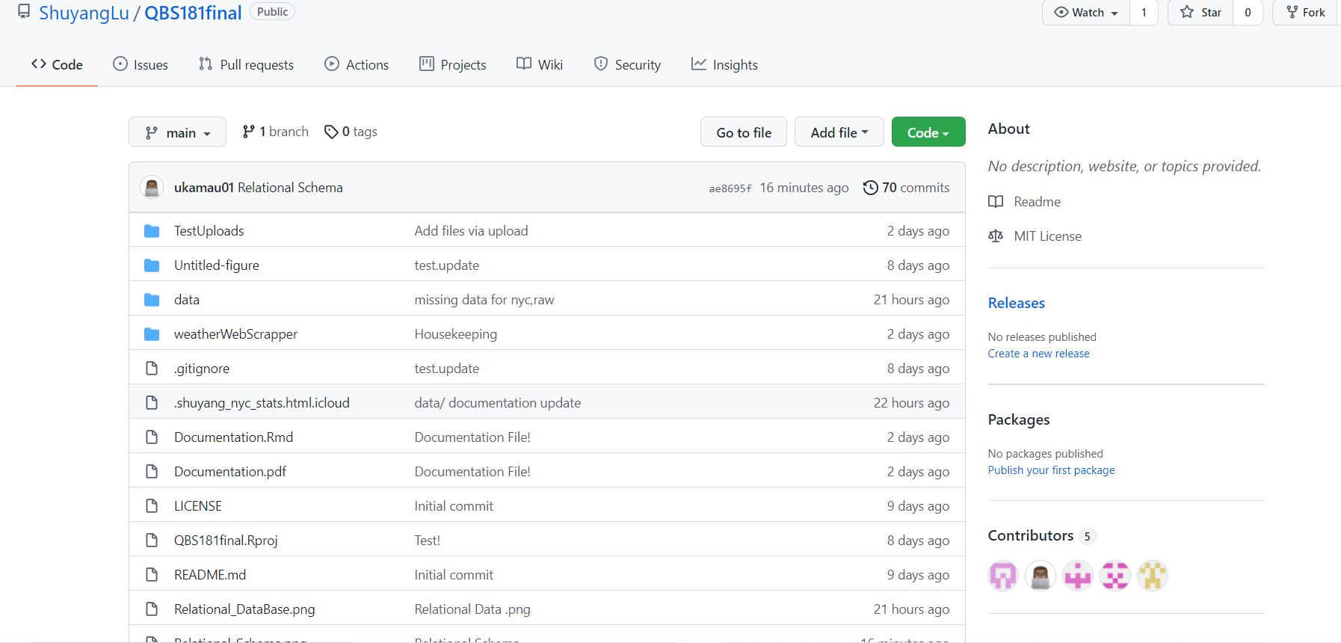
Github

Slide 8
Data Analyzing
Temperature & Humidity to COVID
Statistical Analysis
Data Visualization
Modeling Building (and prediction): 20 days autoregression with weather as outer variable
Ultraviolet to COVID
statistical analysis
Data Visualization

Slide 9
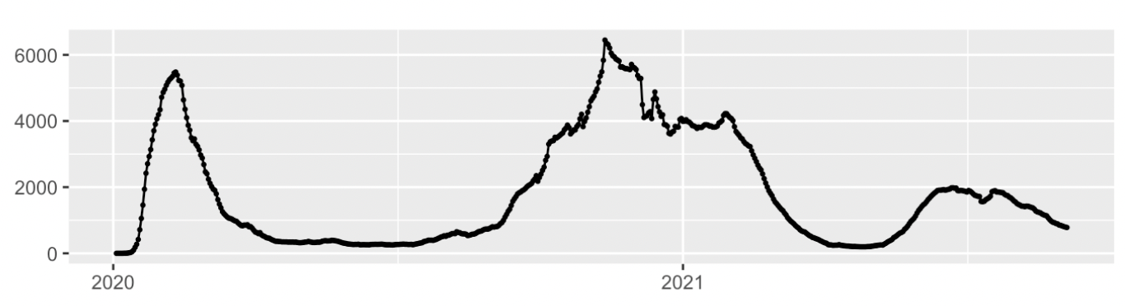
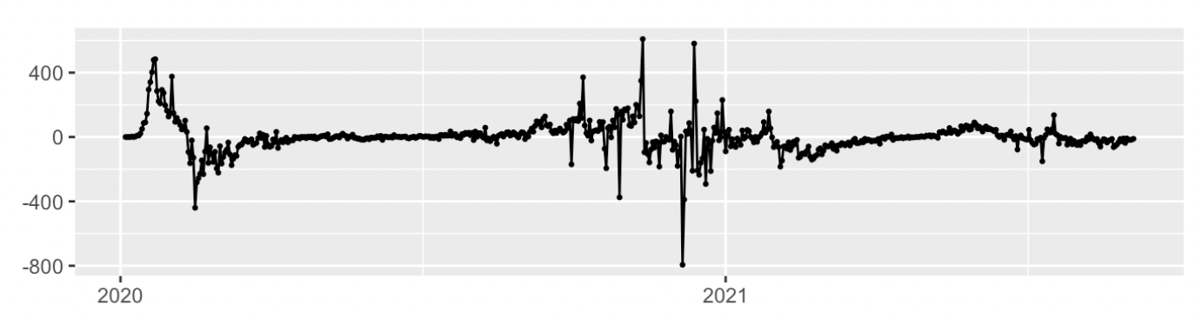
Preparation for the models
The time series plot of the incidence of COVID-19
Differentiation of the time series

Slide 10
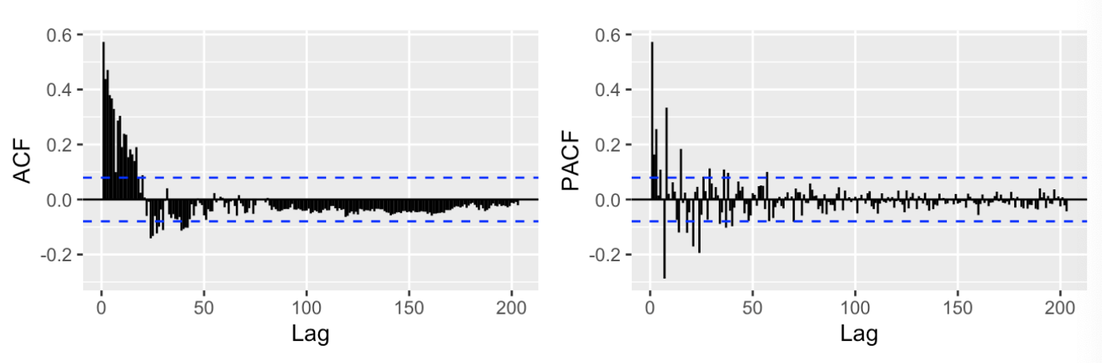
Preparation for the models
ACF and PACF for the differentiated time series

Slide 11
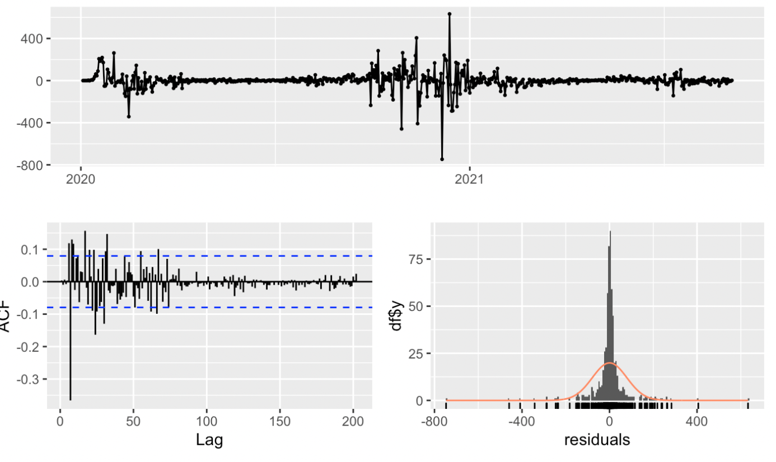
Single-variable Model
 | AR1 | MA1 | MA2 | MA3
PARAMETER | 0.8361 | -0.4127 | -0.1322 | 0.1599
S.E | 0.0491 | 0.0568 | 0.0496 | 0.0498
Parameters of the Model 1
Residual Diagnose for model 1

Slide 12
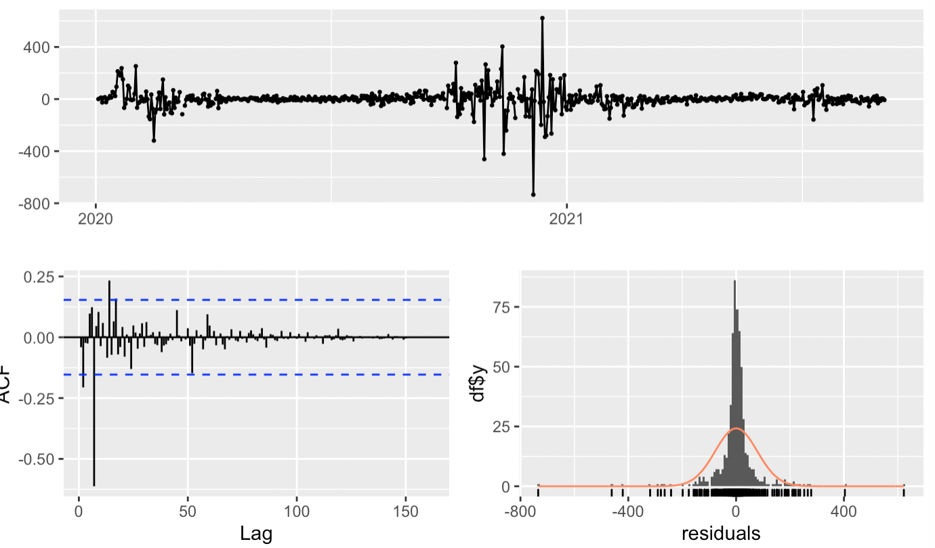
Multi-variable model
 | AR1 | AR2 | AR3 | Xreg
PARAMETER | 0.4595 | 0.0177 | 0.2605 | -0.6175
S.E | 0.0395 | 0.0438 | 0.0391 | 0.1781
Parameters of model with external variables
Residual diagnosis of the
final multi-variable model
AIC:6950.91 VS 7058.9

Slide 13
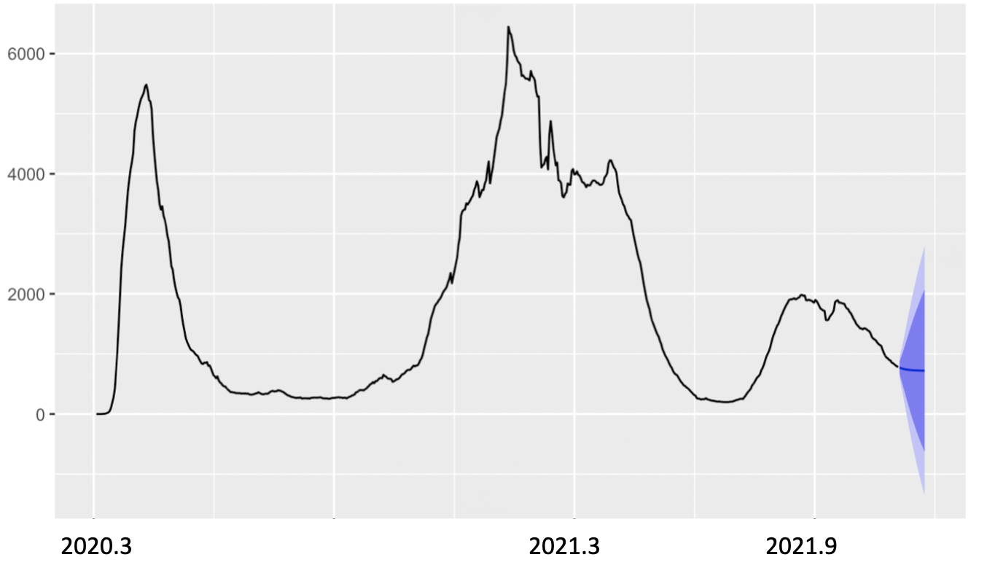
Prediction

Slide 14
Conclusion
1.There is a significant relationship between the ultraviolet and the incident rate of Covid-19
2.Predict the next 20 days for the change of the incident rate of Covid-19

Slide 15
limitation
1. the relationship we found between ultraviolet and Covid-19 is qualitative but not quantitative so we cannot get a general model for all range of ultraviolet.
2. the model we created did not pass the pertemanteau Test for Residual, which means we did not generate a well-fitted one but there should be much better one to obtain.
3. Our case count can be lower than actual due to insufficient report and case definition varied over time(symptom to neg/pos, anti-body test etc.)

Slide 16
Reference
World Health Organization. (n.d.). Who coronavirus (COVID-19) dashboard. World Health Organization. Retrieved October 7, 2021, from https://covid19.who.int/.
Shereen, M. A., Khan, S., Kazmi, A., Bashir, N., & Siddique, R. (2020, March 16). Covid-19 infection: Emergence, transmission, and characteristics of human coronaviruses. Journal of Advanced Research. Retrieved October 7, 2021, from https://www.sciencedirect.com/science/article/pii/S2090123220300540.
Sohrabi, C., Alsafi, Z., O'Neill, N., Khan, M., Kerwan, A., Al-Jabir, A., Iosifidis, C., & Agha, R. (2020, February 26). World Health Organization declares global emergency: A review of the 2019 novel coronavirus (COVID-19). International Journal of Surgery. Retrieved October 7, 2021, from https://www.sciencedirect.com/science/article/pii/S1743919120301977?casa_token=WTZxwhWNuLEAAAAA%3AA3C3_1UK_TKBVPQGVcSEiXa7opKEYR2GcCfCRKIKRo1no1fhQo8rlaKkxeY8LvK4H4WbaiDBdA
Methodological issues in evaluation models: The - ProQuest. (n.d.). Retrieved October 7, 2021, from https://www.proquest.com/docview/215248843?pq-origsite=gscholar&fromopenview=true.
Chin, A. W. H., Chu, J. T. S., Perera, M. R. A., Hui, K. P. Y., Yen, H.-L., Chan, M. C. W., Peiris, M., & Poon, L. L. M. (2020, January 1). Stability of SARS-COV-2 in different environmental conditions. Med Rxiv. Retrieved October 7, 2021, from https://www.medrxiv.org/content/10.1101/2020.03.15.20036673v2.
Ma, Y., Zhao, Y., Liu, J., He, X., Wang, B., Fu, S., Yan, J., Niu, J., Zhou, J., & Luo, B. (2020, March 26). Effects of temperature variation and humidity on the death of covid-19 in Wuhan, China. Science of The Total Environment. Retrieved October 7, 2021, from https://www.sciencedirect.com/science/article/pii/S0048969720317393?casa_token=TOC0gvxaQFoAAAAA%3AJPatyZEbY0V0esSH0ORsJh5jB_3y-5UXFaUDPFbXV5pxJnPqph7jS1nWC7gYvykUGk5Efqvcog.
Eslami, H., & Jalili, M. (2020, May 15). The role of environmental factors to transmission of SARS-COV-2 (COVID-19). AMB Express. Retrieved October 7, 2021, from https://www.ncbi.nlm.nih.gov/pmc/articles/PMC7226715/

Slide 17
Thanks
Q & A

